Slide 1
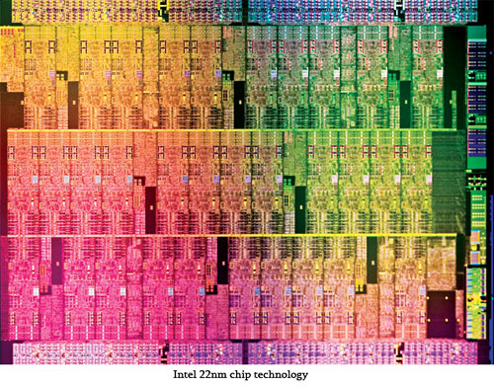
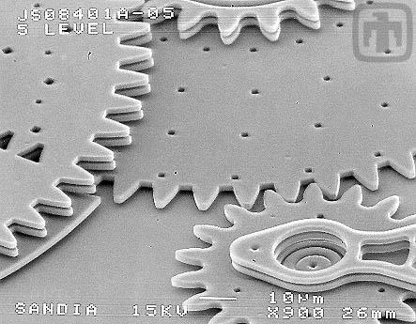
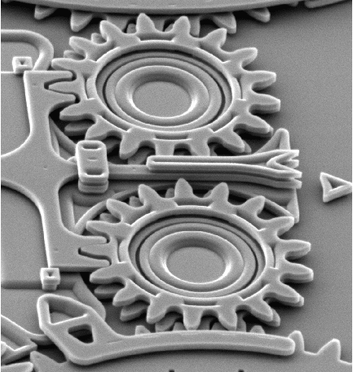
Welcome to ChE 384T/323
Chemical Engineering for Micro/Nano Fabrication
Grant Willson
http://willson.cm.utexas.edu

Slide 2
My Goal:
Students should finish this course with a firm back ground understanding of the high resolution patterning processes practiced by the semiconductor industry….and a bit of history
We will follow a historical outline from invention of the transistor to the challenges of today
and…...have some fun while learning

Slide 3
Course Information
Please read the syllabus carefully
Class web site is http://willson.cm.utexas.edu
Lecture notes and announcements will be posted on our site
This is a lecture Course…
  Please ask questions…..many questions!
  Make every effort to attend each lecture and presentation
  There is no text but there will be reading assignments
Undergrad course (323) vs Grad Course (384T)
  Oral Presentation for grad students.
  Undergrads and Graduates will be graded separately
Periodic Quizes
  Start at 09:30 AM Sharp …..drop lowest score
Grade
  (UG) = 0.5(final)+0.4(best midterm)+0.1(quiz)
  (Grad) = 0.1(presentation)+0.4(best midterm)+0.4(Final)+0.1(Quiz)
Teaching assistant: Miss Ji Yeon Kim
  See the syllabus for office hours

Slide 4
Course Information
Note the dates of the exams. If you miss an exam that will be your dropped score. There is really no way to make up these exams.
Students with disabilities may request appropriate academic accommodations from the Division of Diversity and Community Engagement, Services for Students with Disabilities, 512-471-6259, http://diversity.utexas.edu/disability/
Occupants of buildings on The University of Texas at Austin campus are required to evacuate buildings when a fire alarm is activated. Alarm activation or announcement requires exiting and assembling outside and across the bridge to assemble between ECJ and RLM.
  Familiarize yourself with all exit doors of each classroom and building you may occupy. Remember that the nearest exit door may not be the one you used when entering the building.
  Students requiring assistance in evacuation shall inform their instructor in writing during the first week of class.
  Do not re-enter a building unless given instructions by the following: Austin Fire Department, The University of Texas at Austin Police Department, or Fire Prevention Services office.

Slide 5
Grad Student Presentation
I will assign a topic and a date
  leading references will be provided
  Meet with me in advance to discuss the presentation
Prepare a PowerPoint presentation
  I will provide copies of your presentation to the class
Presentation should be 20 minutes plus questions
Grading done by the students
Please prepare 3x5 card

Slide 6
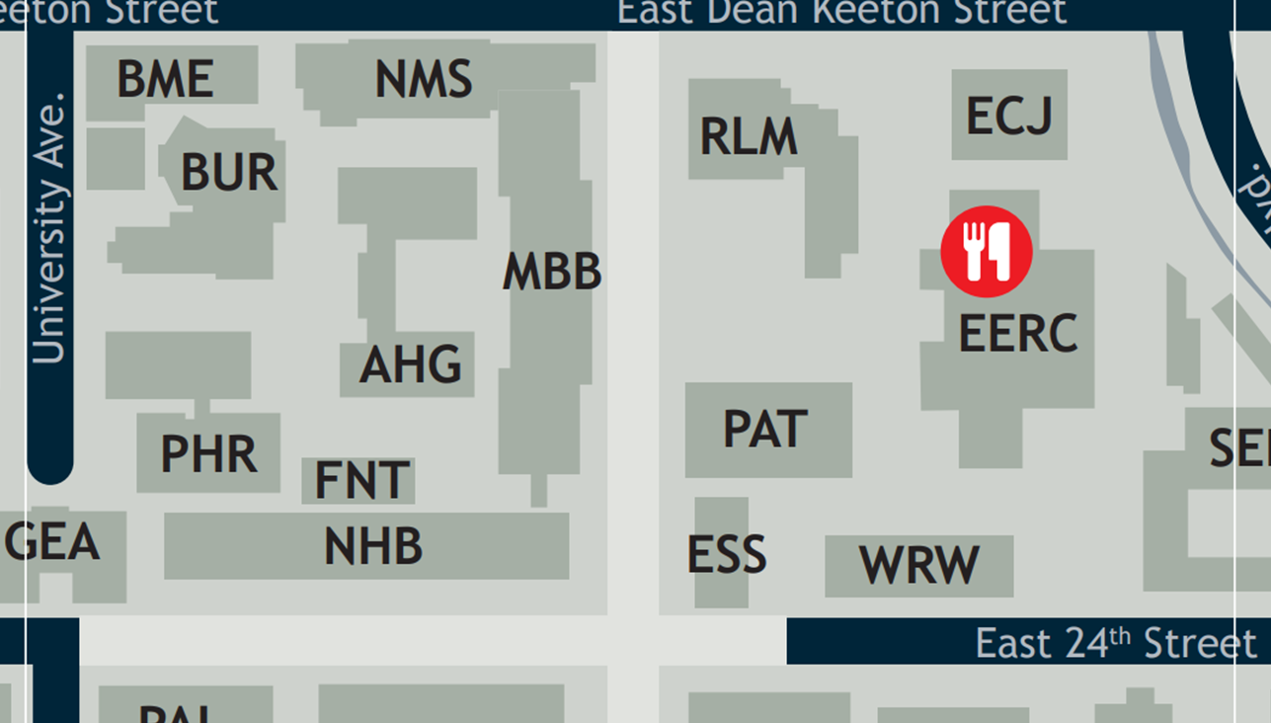
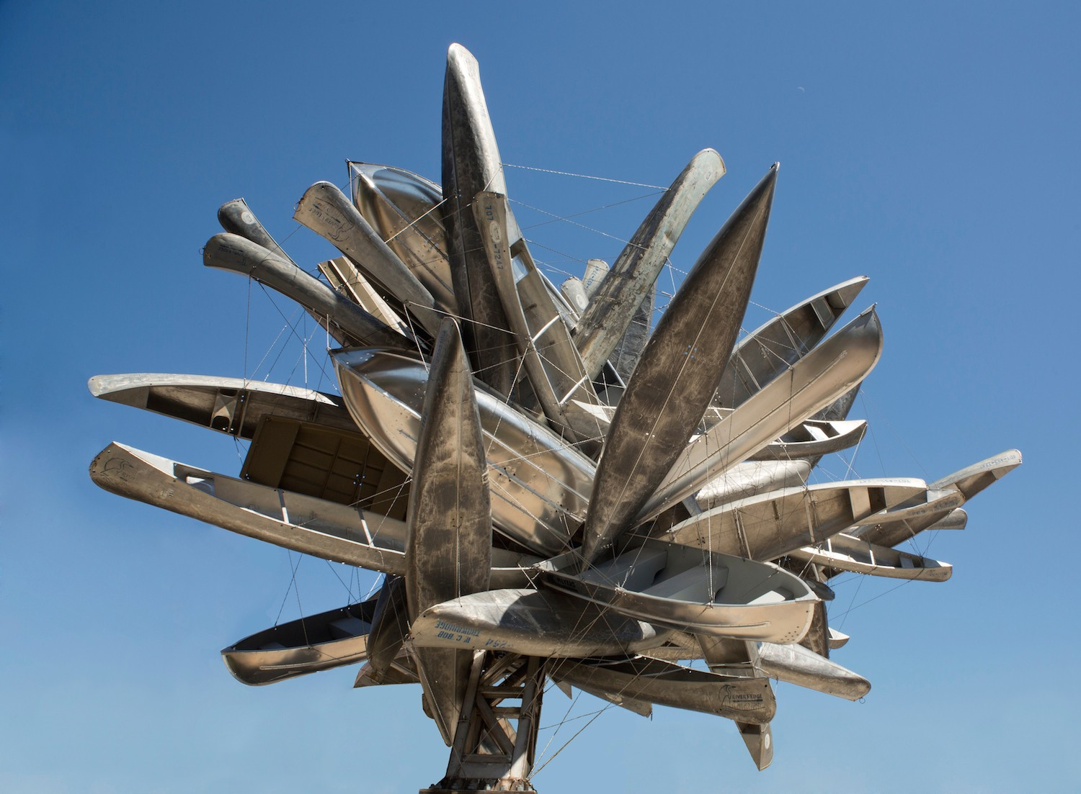
Evacuation Route

Slide 7
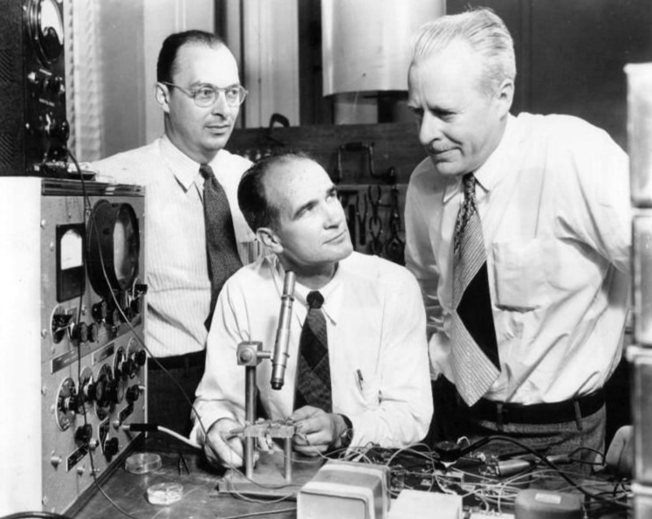
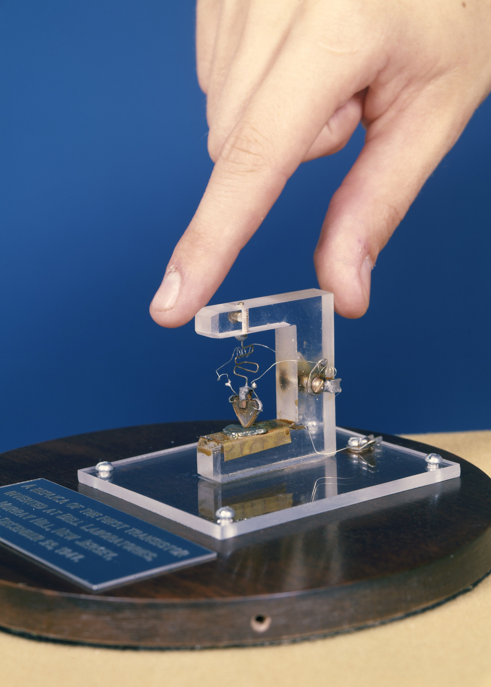
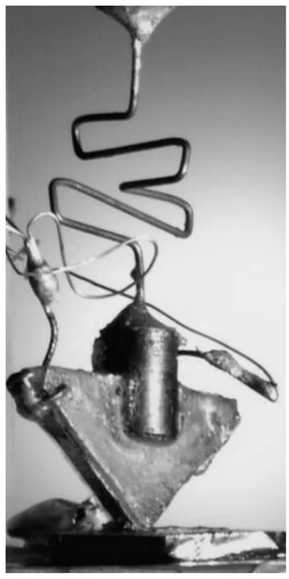
The First Transistor 1948
John Bardeen, William Shockley and Walter Brattain at Bell Labs, 1948.

Slide 8
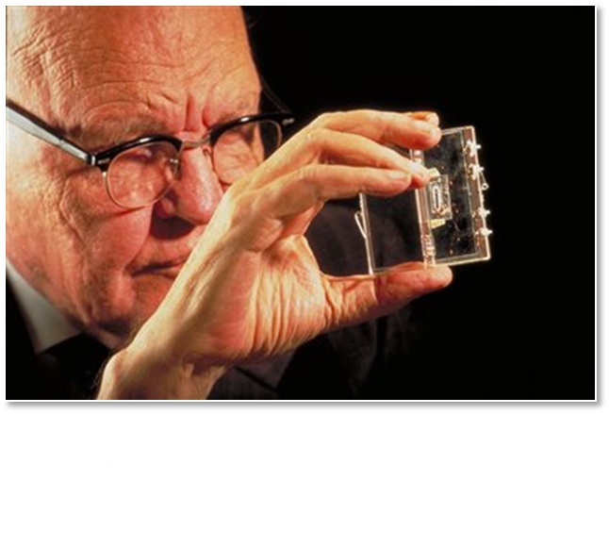
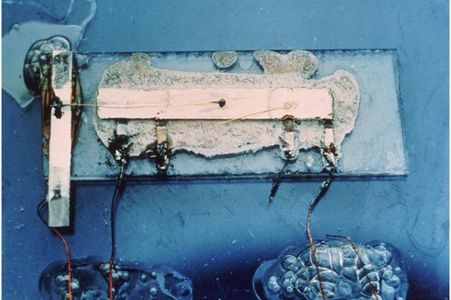
First Integrated Circuit 1958
Jack Kilby with the first integrated circuit - 1958
Nobel Prize 2000

Slide 9
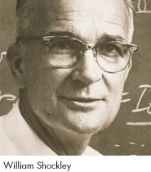
William Shockley Founds Shockley Semiconductor 1955
William Shockley, co-inventor of the transistor seven years earlier, founded Shockley Semiconductor Laboratories in Santa Clara Valley. He recruited 12 young scientists dedicated to the use of germanium and silicon for transistors -- his "Ph.D. production line."
Shockley won the Nobel Prize¨ for Physics in 1956, but his management style and disenchantment with pure research caused the eight young scientists to leave company.

Slide 10
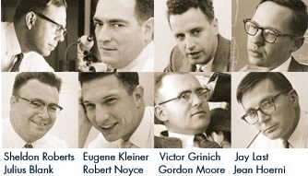
The "Traitorous Eight" Develop A Method Of Mass Producing Silicon Transistors 1957
Formed Fairchild Semiconductor in San Jose

Slide 11
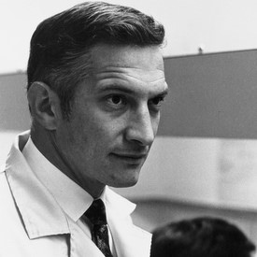
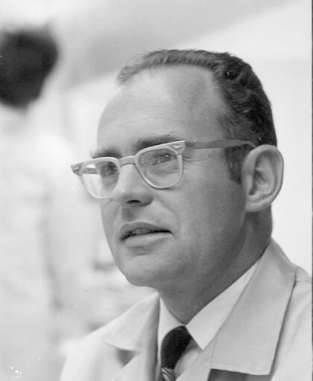
Founders of Intel Corp 1968
Robert Noyce
Gordon Moore
Intel was founded on July 18, 1968, by semiconductor pioneers Robert Noyce and Gordon Moore, who left Fairchild Semiconductor to do so. Originally called “NM Electronics” for Noyce and Moore, the company purchased the rights to use the name “Intel,” short for Integrated Electronics, from a company called Intelco.Jul 18, 2012

Slide 12
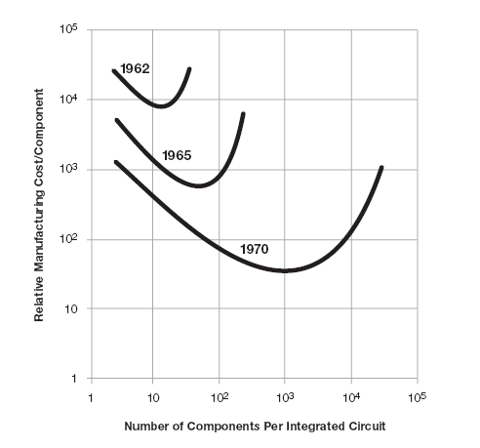
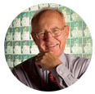
Moore’s Law

Slide 13
Moore’s Law

Slide 14
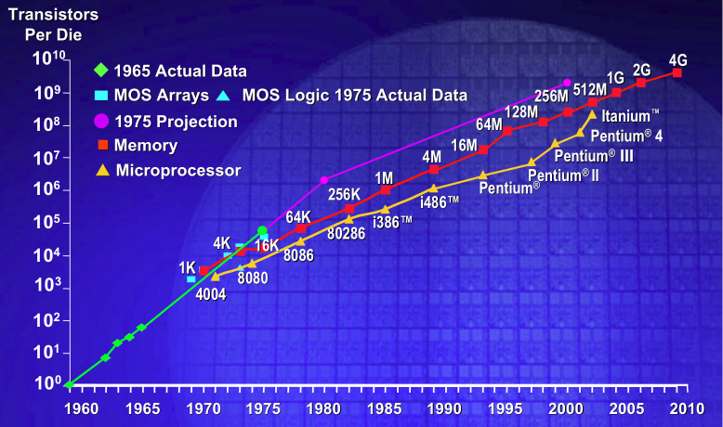


Moore’s Law
☺
$am$ung…
Int€£
T$M¢
Hitachi
Sony ??
Fairchild
Siemens

Slide 15
The Driving Force for Progress is $$$

Slide 16
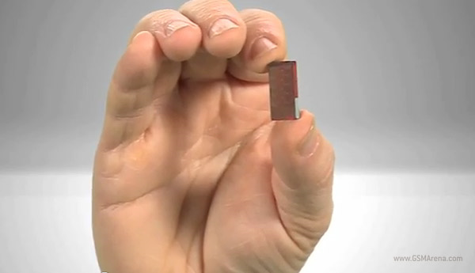
1.4 Billion Transistors
Integrated Circuits Today
Intel microprocessor with 22 nm minimum features
  Features are smaller than a virus!
One of these transistors costs less than one printed character in the Austin American Statesman!!

Slide 17
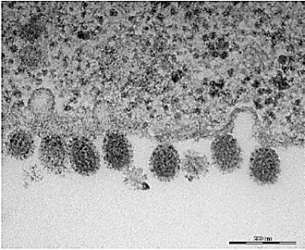
Smaller than a virus!!
Influenza virus (~ 100nm)
a 20nm line

Slide 18
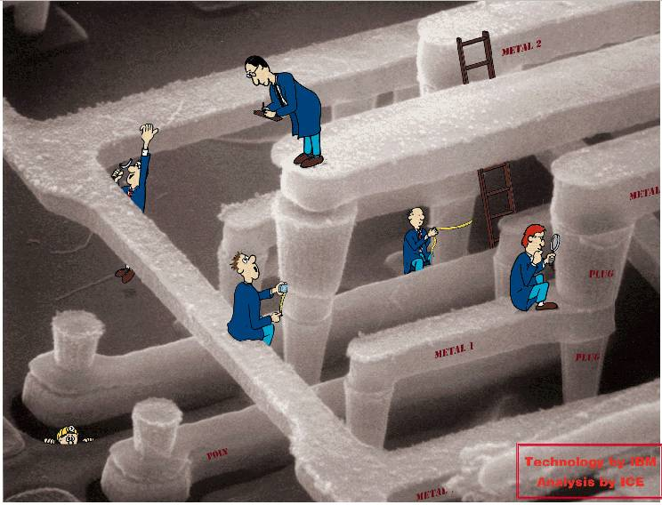
Our job….Learn to make them still smaller!
Gordon Moore
You?

Slide 19

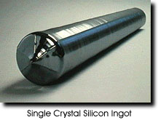
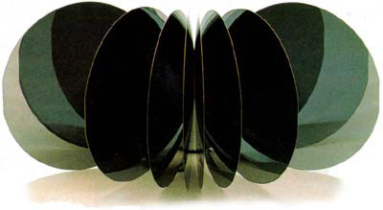
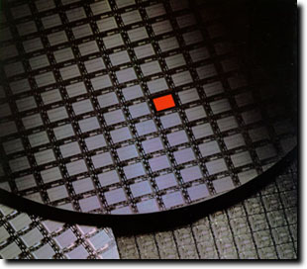
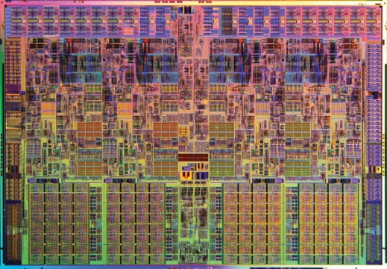
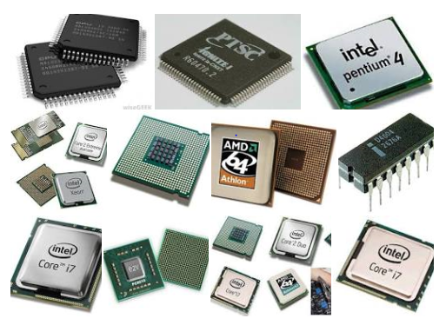
This all starts with single crystal Silicon wafers
Polished Si Wafers
sand
Single crystal Si Ingot
Device Wafer
Packaged devices
“Chip”

Slide 20
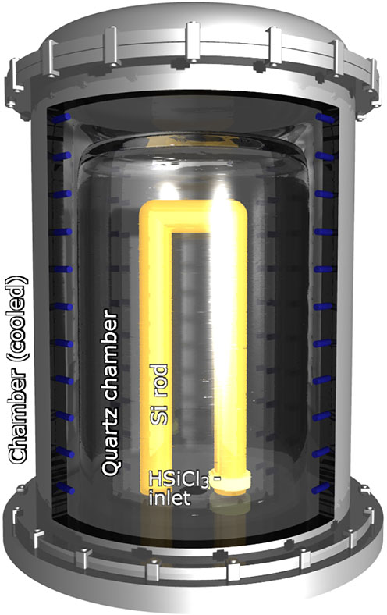
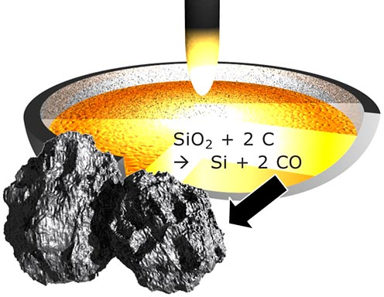
SiO₂ to Poly Silicon
Purification as HSiCl₃ produces 99.9999999% purity
Si + 3 HCl  HSiCl₃ + H₂
Reduction with Carbon

Slide 21
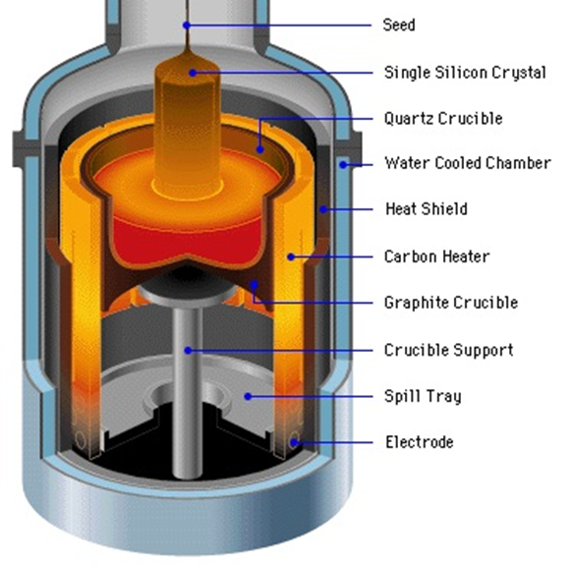
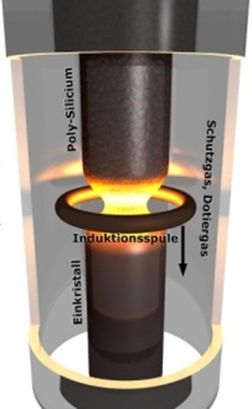
Silicon Crystal Growth
Czochralski-Technique:
Float-Zone Technique:

Slide 22
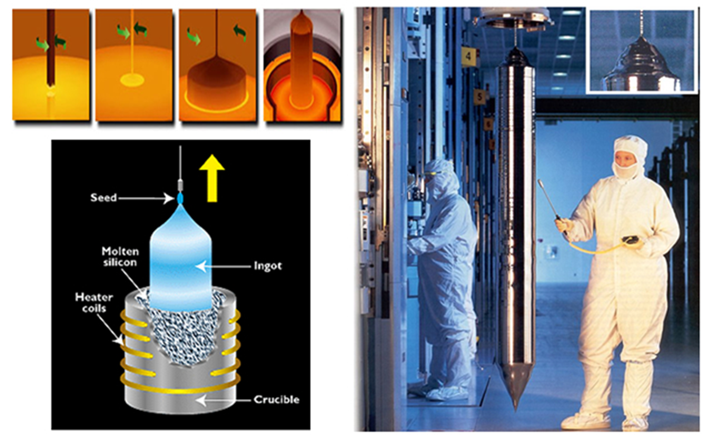

Slide 23
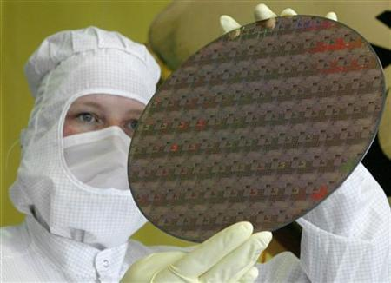
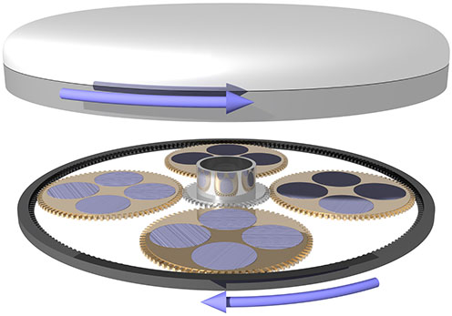
Lapping to Smooth the Wafer
450 mm Wafer

Slide 24
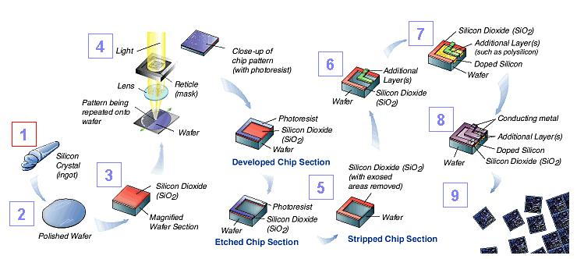
~400 Unit Processes are required

Slide 25

Integrated Circuit Fabrication
The fabrication of an integrated circuit requires hundreds of
sequential process steps involving:
Silicon Wafer
Deposit
Layer
Protective
Coating
Prepare
Surface
Pattern
Photoresist
Etch
Pattern
Remove
Residue
Etch
Substrate
Dice
Chip

Slide 26
Photolithographic Process
Photoresist
Substrate
Coating
hυ
Mask
Exposure
Negative
Positive
Develop
Transfer
Strip
Photoresist

Slide 27
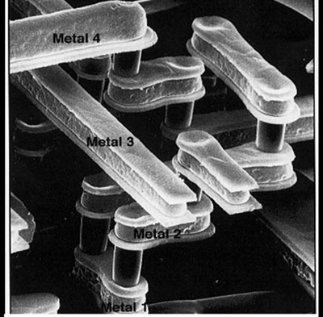

Chip Schematic
Back-end
Processing
(definition of contacts
and interconnects)
Al Copper
Passivation
Metal 4
Metal 3
SiO₂ Low-k Insulator
ILD
Metal 2
Metal 2
SiO₂ High-k Insulator
Metal 1
W
poly
nitride
Front-end
Processing
(generation of active devices)
Strained Silicon
p-well
fox
n-well
Notes:
The functional components of the electronic circuit are constructed in silicon by doping the substrate in specific areas to alter its electrical properties. The example shown here is that of a transistor. The electronic elements are interconnected by metallic pathways that are fabricated in multiple levels and insulated from each other by a dielectric. Shown is a CMOS structure
The electrical properties of a circuit are determined in part by the materials from which it is constructed. As features have gotten smaller and smaller, manufacturers have been running up against the physical limitations of those materials. This, in turn, has spawned a series of innovations in circuit design, new materials (from 25 elements of the Periodic Table to over 60 elements today).
Silicon dioxide to high-k dielectrics for the gate and ILD
Aluminum to copper
Strained silicon [Introduced at 90nm feature size. Early 2,000s. Source and drain constructed from Si-Ge which generates a compressive strain on the gate region.
2009_ 32 nm technology. Our analysis shows that this 32 nm process continues to keep Intel ahead of the game. The transistor design is very different than what we saw in the previous generation 45 nm high-k metal gate process, which was itself a radical design when compared to the competition. The Westmere employs second generation metal gates and second generation low-k dielectrics in the metallization stack,

Slide 28
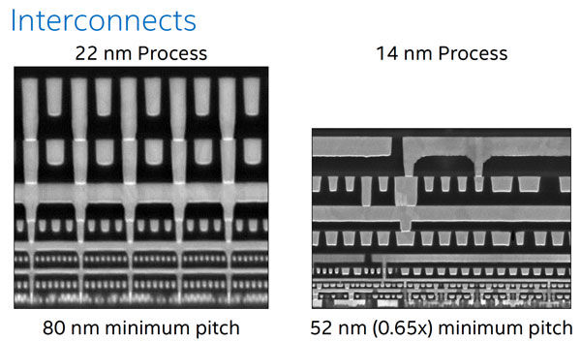
Continuing Progress at Intel

Slide 29
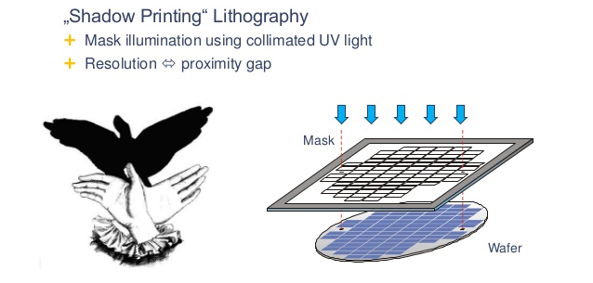
Shadow Printing Lithography

Slide 30
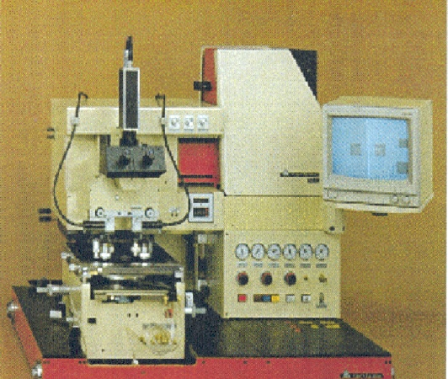
It all Started With Contact Printing
Element of
the Condenser
Mirror
Heat Removing Filter
Point
Source
Shutter
Spherical
Mirror
Element of
the Condenser
Mask
Resist
X-movement
Wafer
Swiveling
movement
Z-movement
Notes:
The light source is usually a point source, typically a gas discharge arc lamp such as Xenon (Xe), or Mercury (Hg) arc lamps chosen for high efficiency in the desired spectral region.
The photomask is pressed against the wafer with a pressure of 0.05 – 0.3Atm.
Advantage: The mask contains all the patterns for all of the chips on the wafer. So every pattern is exposed in a single exposure.
How good is the technique?

Slide 31
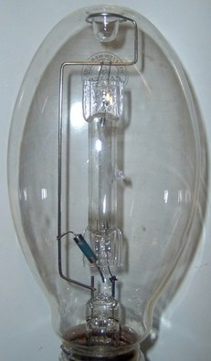
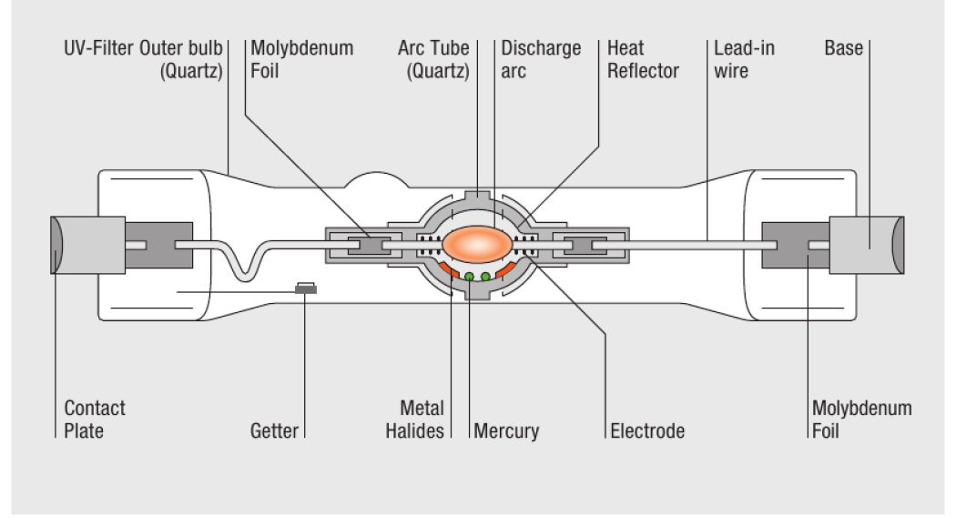
High Pressure Hg Lamp

Slide 32
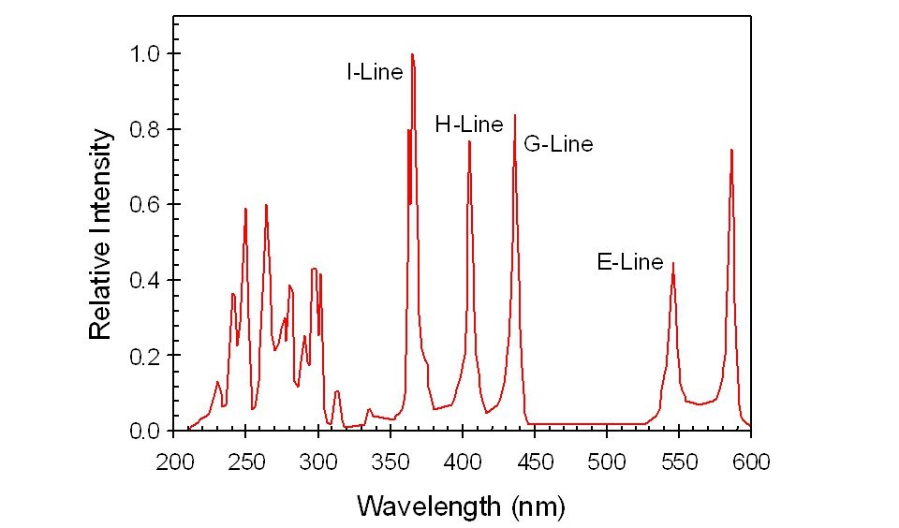
High Pressure Hg Lamp Output

Slide 33
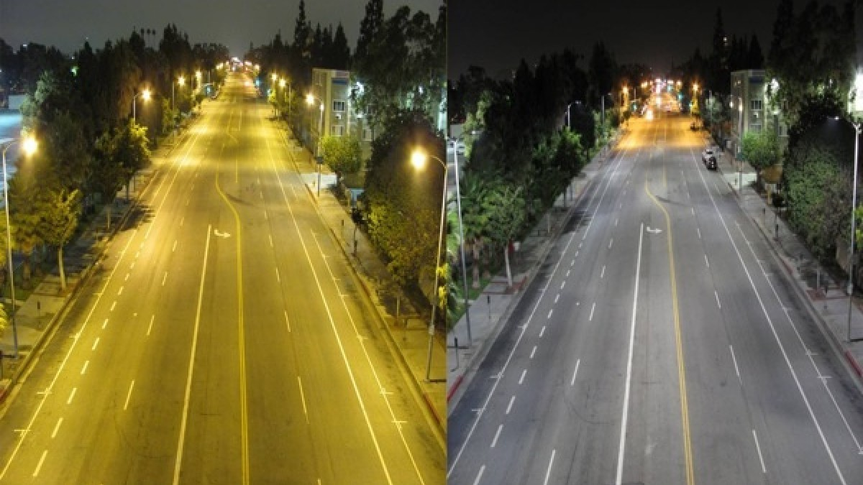
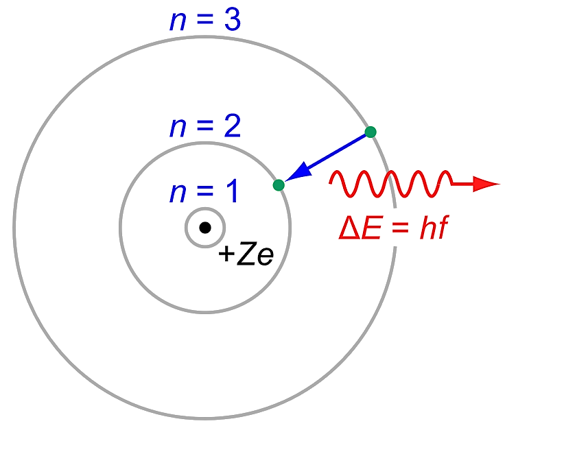
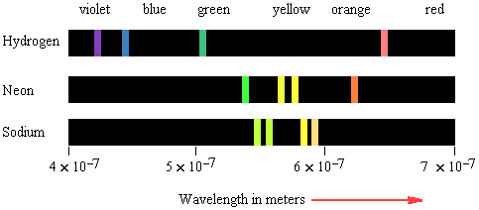
The Balmer Series

Slide 34
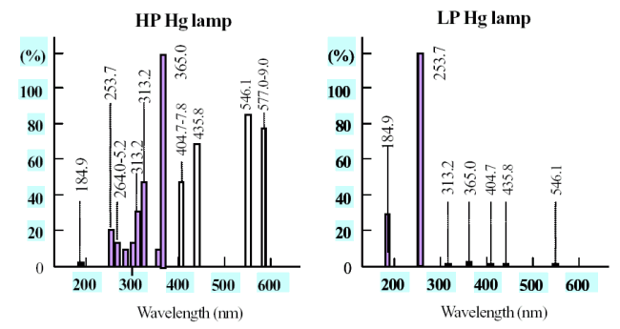
High and Low Pressure Hg Lamps

Slide 35
MASK
Glass
LIGHT
I_{max}
Chrome
I_{min}
I_{max}
I_{min}
I_{max}
I_{max} – I_{min}
I_{max} + I_{min}
MODULATION =
Notes:
Modulation is also known as OPTICAL CONTRAST

Slide 36
Modulation in Contact Printing
RESIST
MASK
WAFER
ILLUMINATION
I_{max} – I_{min}
I_{max} + I_{min}
MODULATION =
1
Modulation of the mask is ?
Modulation of the image is ?
~1
The image is almost perfect!
Notes:
Problem is that the mechanical contact between the mask and wafer causes defects on the mask and wafer with consequent negative impact on productivity.

Slide 37
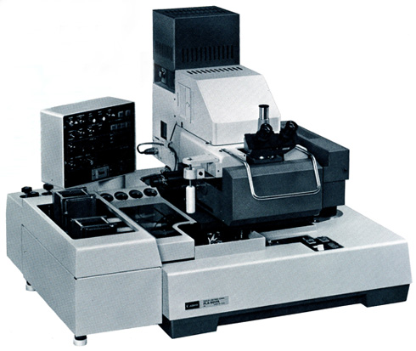
Mask Aligner

Slide 38
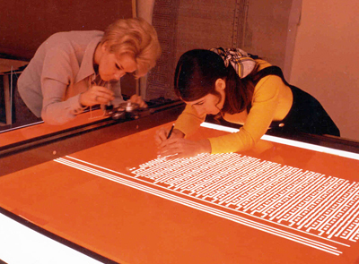
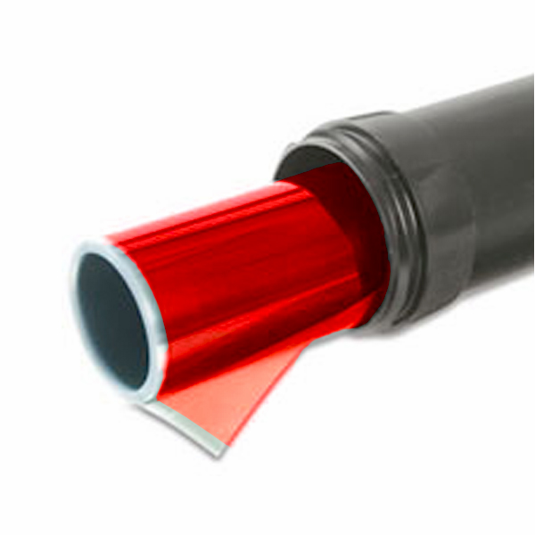
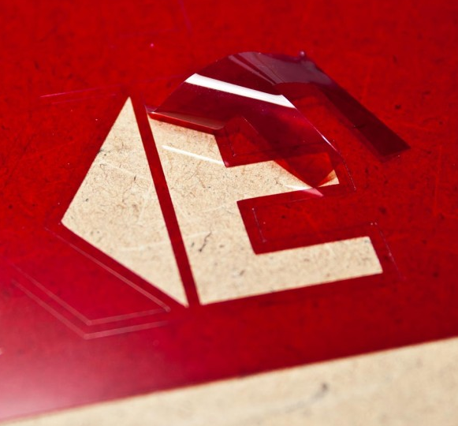
Rubylith Mask Making

Slide 39
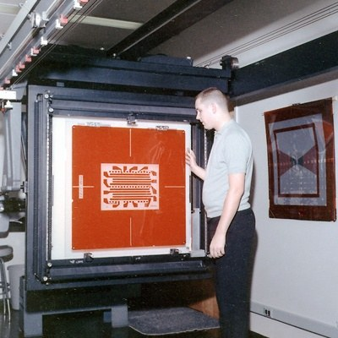
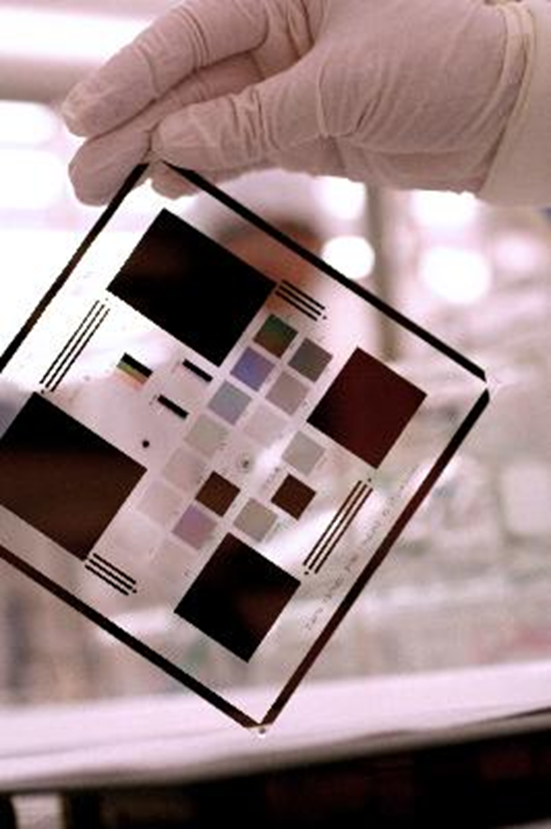
Rubylith Mask Making

